Slide 1
Unit-2
JDBC

Slide 2
JDBC - Java Database Connectivity.
JDBC from Sun Microsystems provides API or Protocol to interact with different databases.
With the help of JDBC driver we can connect with different types of databases.
Driver is must needed for connection establishment with any database.
A driver works as an interface between the client and a database server.

Slide 3
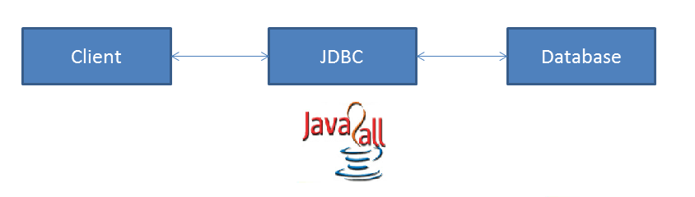

Slide 4
JDBC have so many classes and interfaces that allow a java application to send request made by user to any specific DBMS(Data Base Management System).
JDBC supports a wide level of portability.
JDBC provides interfaces that are compatible with java application
Platform independent interface between relational database & java.

Slide 5
JDBC Components
The JDBC API - it provides various methods and interfaces for easy communication with database.
The JDBC DriverManager - it loads database specific drivers in an application to establish connection with database.
The JDBC test suite - it will be used to test an operation being performed by JDBC drivers.
The JDBC-ODBC bridge - it connects database drivers to the database.

Slide 6
JDBC Specification:
JDBC 1.0 - it provides basic functionality of JDBC
JDBC 2.0 - it provides JDBC API(JDBC 2.0 Core API and JDBC 2.0 Optional Package API).
JDBC 3.0 - it provides classes and interfaces in two packages(java.sql and javax.sql).
JDBC 4.0 - it provides so many extra features like
Auto loading of the driver interface.
Connection management
ROWID data type support.
Enhanced support for large object like BLOB(Binary Large Object) and CLOB(Character Large Object).
Exception Handling

Slide 7
JDBC Architecture
As we all know now that driver is required to communicate with database.
JDBC API provides classes and interfaces to handle request made by user and response made by database.
Some of the important JDBC API are as under.
DriverManager
Driver
Connection
Statement

Slide 8
PreparedStatement
CallableStatement
ResultSet
DatabaseMetaData
ResultSetMetaData
Here The DriverManager plays an important role in JDBC architecture.
It uses some database specific drivers to communicate our J2EE application to database.

Slide 9
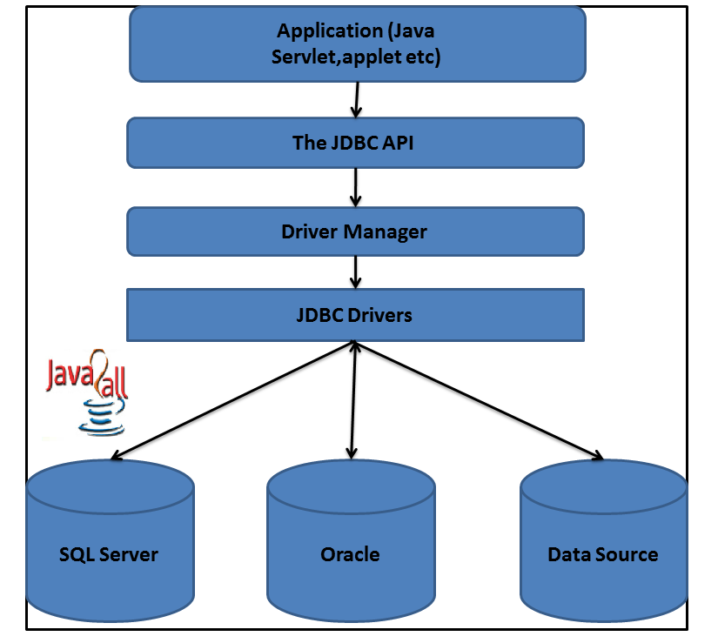

Slide 10
With the help of DriverManager class than we connect to a specific database with the help of specific database driver.
Java drivers require some library to communicate with the database.
We have four different types of java drivers.
Some drivers are pure java drivers and some are partial.
So with this kind of JDBC architecture we can communicate with specific database.

Slide 11
JDBC Driver Types:
There are four categories of drivers by which developer can apply a connection between Client (The JAVA application or an applet) to a DBMS.
(1) Type 1 Driver : JDBC-ODBC Bridge.
(2) Type 2 Driver : Native-API Driver (Partly Java driver).
(3) Type 3 Driver : Network-Protocol Driver (Pure Java driver for database Middleware).
(4) Type 4 Driver : Native-Protocol Driver (Pure Java driver directly connected to database).

Slide 12
Type 1 Driver: JDBC-ODBC Bridge :-
The JDBC type 1 driver which is also known as a JDBC-ODBC Bridge is a convert JDBC methods into ODBC function calls.
Sun provides a JDBC-ODBC Bridge driver by “sun.jdbc.odbc.JdbcOdbcDriver”.
The driver is a platform dependent because it uses ODBC which is depends on native libraries of the operating system and also the driver needs other installation for example, ODBC must be installed on the computer and the database must support ODBC driver.

Slide 13
Type 1 is the simplest compare to all other driver but it’s a platform specific i.e. only on Microsoft platform.
The JDBC-ODBC Bridge is use only when there is no PURE-JAVA driver available for a particular database.

Slide 14
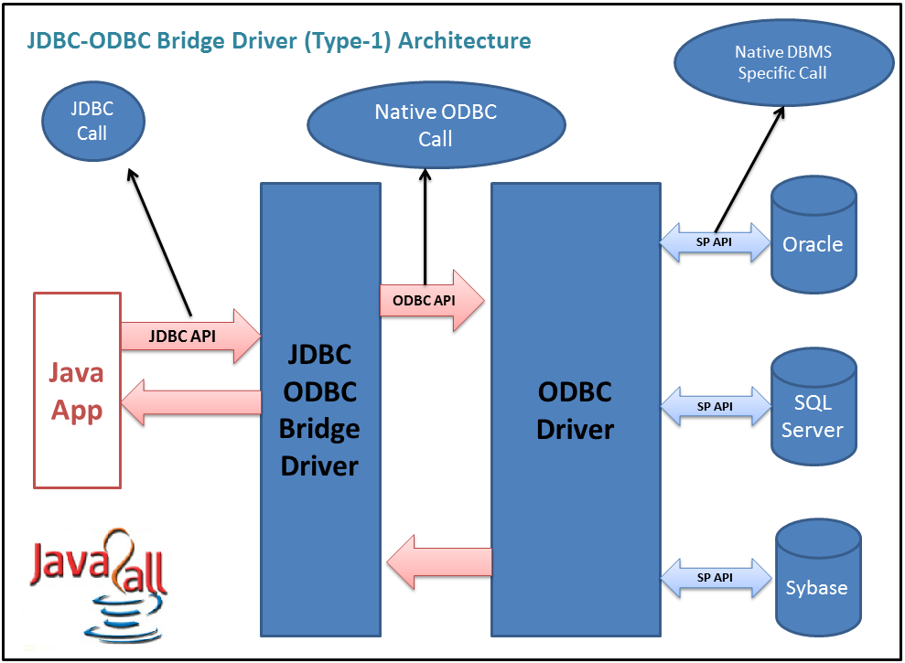
Type-1 Driver

Slide 15
Process:
Java Application → JDBC APIs → JDBC Driver Manager → Type 1 Driver → ODBC Driver → Database library APIs → Database
Advantage:
(1) Connect to almost any database on any system, for which ODBC driver is installed.
(2) It’s an easy for installation as well as easy(simplest) to use as compare the all other driver.
(3) Vendor independent driver.

Slide 16
Disadvantage:
(1) The ODBC Driver needs to be installed on the client machine.
(2) It’s a not a purely platform independent because its use ODBC which is depends on native libraries of the operating system on client machine.
(3) Not suitable for applets because the ODBC driver needs to be installed on the client machine.
(4) Decrease speed due to large translations.
(5) use of JNI( Java Native Interface)

Slide 17
Type 2 Driver: Native-API Driver (Partly Java driver) :-
The JDBC type 2 driver is uses the libraries of the database which is available at client side and this driver converts the JDBC method calls into native calls of the database so this driver is also known as a Native-API driver.

Slide 18
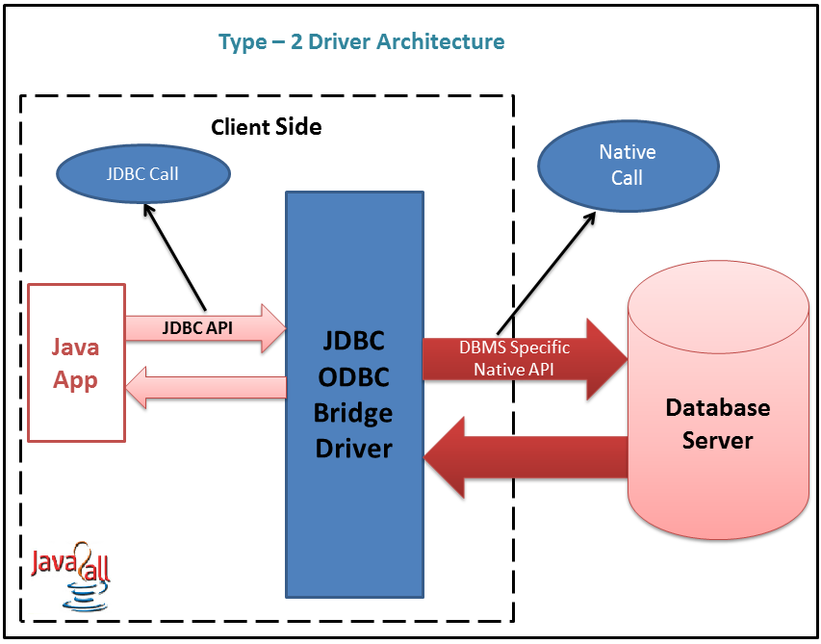

Slide 19
Process:
Java Application → JDBC APIs → JDBC Driver Manager → Type 2 Driver → Vendor Client Database library APIs → Database
Advantage:
(1) There is no implentation of JDBC-ODBC Bridge so it’s faster than a type 1 driver; hence the performance is better as compare the type 1 driver (JDBC-ODBC Bridge).

Slide 20
Disadvantage:
(1) On the client machine require the extra installation because this driver uses the vendor client libraries.
(2) The Client side software needed so cannot use such type of driver in the web-based application.
(3) Not all databases have the client side library.
(4) This driver supports all JAVA applications except applets.
(5) Increase cost in case it run on different platforms.

Slide 21
Type 3 Driver: Network-Protocol Driver (Pure Java driver for database Middleware) :-
The JDBC type 3 driver uses the middle tier(application server) between the calling program and the database and this middle tier converts JDBC method calls into the vendor specific database protocol and the same driver can be used for multiple databases also so it’s also known as a Network-Protocol driver as well as a JAVA driver for database middleware.

Slide 22
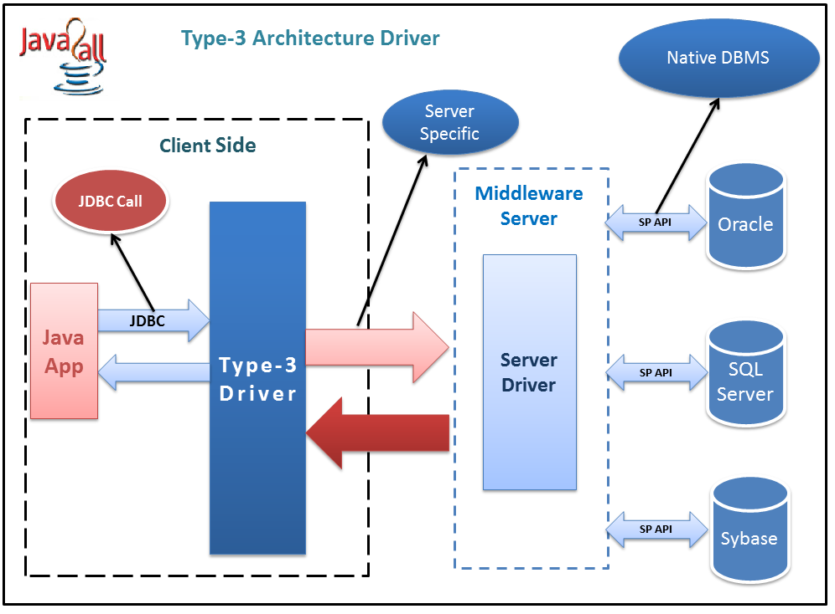

Slide 23
Process:
Java Application → JDBC APIs → JDBC Driver Manager → Type 3 Driver → Middleware (Server)→ any Database
Advantage:
(1) There is no need for the vendor database library on the client machine because the middleware is database independent and it communicates with client.
(2) Type 3 driver can be used in any web application as well as on internet also because there is no any software require at client side.

Slide 24
(3) A single driver can handle any database at client side so there is no need a separate driver for each database.
(4) The middleware server can also provide the typical services such as connections, auditing, load balancing, logging etc.
Disadvantage:
(1) An Extra layer added, may be time consuming.
(2) At the middleware develop the database specific coding, may be increase complexity.

Slide 25
Type 4 Driver: Native-Protocol Driver (Pure Java driver directly connected to database)
The JDBC type 4 driver converts JDBC method calls directly into the vendor specific database protocol and in between do not need to be converted any other formatted system so this is the fastest way to communicate quires to DBMS and it is completely written in JAVA because of that this is also known as the “direct to database Pure JAVA driver

Slide 26
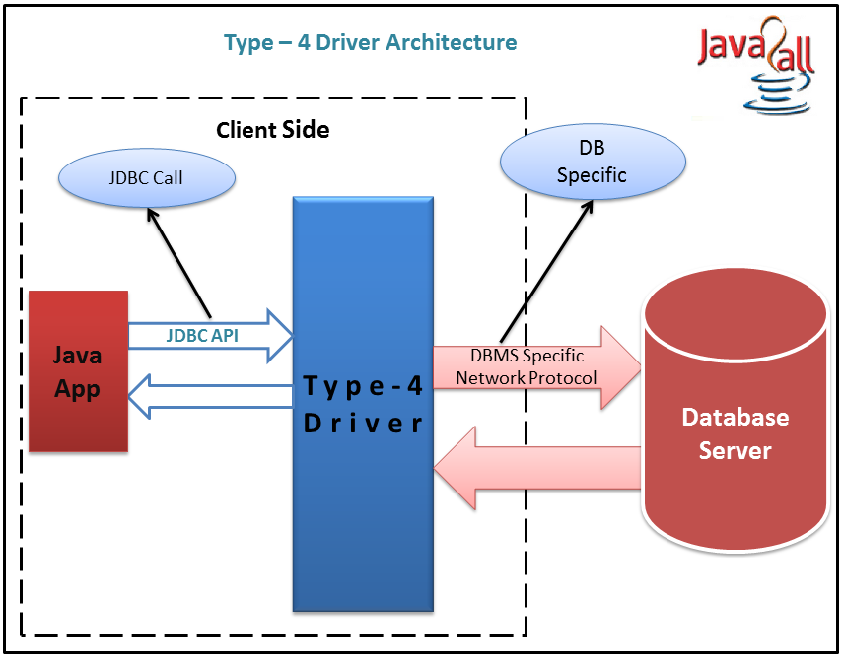

Slide 27
Process:
Java Application → JDBC APIs → JDBC Driver Manager → Type 4 Driver (Pure JAVA Driver) → Database Server
Advantage:
(1) It’s a 100% pure JAVA Driver so it’s a platform independence.
(2) No translation or middleware layers are used so consider as a faster than other drivers.
(3) The all process of the application-to-database connection can manage by JVM so the debugging is also managed easily.

Slide 28
Disadvantage:
(1)There is a separate driver needed for each database at the client side.
(2) Drivers are Database dependent, as different database vendors use different network protocols.

Slide 29
JDBC API
If any java application or an applet wants to connect with a database then there are various classes and interfaces available in java.sql package.
Depending on the requirements these classes and interfaces can be used.
Some of them are list out the below which are used to perform the various tasks with database as well as for connection.

Slide 30
Class or Interface | Description
Java.sql.Connection | Create a connection with specific database
Java.sql.DriverManager | The task of DriverManager is to manage the database driver
Java.sql.Statement | It executes SQL statements for particular connection and retrieve the results
Java.sql.PreparedStatement | It allows the programmer to create prepared SQL statements
Java.sql.CallableStatement | It executes stored procedures
Java.sql.ResultSet | This interface provides methods to get result row by row generated by SELECT statements

Slide 31
Connection Interface
The Connection interface used to connect java application with particular database.
After crating the connection with database we can execute SQL statements for that particular connection using object of Connection and retrieve the results.
The interface has few methods that makes changes to the database temporary or permanently.

Slide 32
Method | Description
void close() | This method frees an object of type Connection from database and other JDBC resources.
void commit() | This method makes all the changes made since the last commit or rollback permanent. It throws SQLExeception.
Statement createStatement() | This method creates an object of type Statement for sending SQL statements to the database. It throws SQLExeception.
boolean isClosed() | Return true if the connection is close else return false.
PreparedStatement prepareStatement(String s) | This method creates an object of type PrepareStatement for sending dynamic (with or without IN parameter) SQL statements to the database. It throws SQLExeception.
void rollback() | This method undoes all changes made to the database.

Slide 33
Statement Interface:
The Statement interface is used for to execute a static query.
It’s a very simple and easy so it also calls a “Simple Statement”.
The statement interface has several methods for execute the SQL statements and also get the appropriate result as per the query sent to the database.

Slide 34
Method | Description
void close() | This method frees an object of type Statement from database and other JDBC resources.
boolean execute(String s) | This method executes the SQL statement specified by s. The getResultSet() method is used to retrieve the result.
ResultSet getResultet() | This method retrieves the ResultSet that is generated by the execute() method.
ResultSet executeQuery(String s) | This method is used to execute the SQL statement specified by s and returns the object of type ResultSet.
int getMaxRows() | This method returns the maximum number of rows those are generated by the executeQuery() method.
Int executeUpdate(String s) | This method executes the SQL statement specified by s. The SQL statement may be a SQL insert, update and delete statement.

Slide 35
JDBC Connection
1 Making a connection with a database with the help of DriverManager class a) DriverManager class: It helps to make a connection with the driver.
b) SQLPermission class: It provides a permission when the code is running within a Security Manager, such as an applet. It attempts to set up a logging stream through the DriverManager class.
c) Driver interface : This interface is mainly used by the DriverManager class for registering and connecting drivers based on JDBC technology.
d). DriverPropertyInfo class : This class is generally not used by the general user.

Slide 36
2). Sending SQL Parameters to a database : a). Statement interface: It is used to send basic SQL statements.
b). PreparedStatement interface: It is used to send prepared statements or derived SQL statements from the Statement object.
c). CallableStatement interface : This interface is used to call database stored procedures.
d). Connection interface : It provides methods for creating statements and managing their connections and properties.
e). Savepoint : It helps to make the savepoints in a transaction.

Slide 37
3). Updating and retrieving the results of a query: a) ResultSet interface: This object maintains a cursor pointing to its current row of data. The cursor is initially positioned before the first row. The next method of the resultset interface moves the cursor to the next row and it will return false if there are no more rows in the ResultSet object. By default ResultSet object is not updatable and has a cursor that moves forward only.

Slide 38
4.) Providing Standard mappings for SQL types to classes and interfaces in Java Programming language. a). Array interface: It provides the mapping for SQL Array. b). Blob interface : It provides the mapping for SQL Blob. c). Clob interface: It provides the mapping for SQL Clob. d). Date class: It provides the mapping for SQL Date. e). Time class: It provides the mapping for SQL Time. f). Timestamp: It provides the mapping for SQL Timestamp. g). Types: It provides the mapping for SQL types.

Slide 39
5) Metadata
a). DatabaseMetaData interface: It keeps the data about the data. It provides information about the database. b). ResultSetMetaData: It gives the information about the columns of a ResultSet object. c). ParameterMetaData: It gives the information about the parameters to the PreparedStatement commands

Slide 40
6). Exceptions
a). SQLException: It is thrown by the mehods whenever there is a problem while accessing the data or any other things. b). SQLWarning: This exception is thrown to indicate the warning. c). BatchUpdateException: This exception is thrown to indicate that all commands in a batch update are not executed successfully. d). DataTruncation: It is thrown to indicate that the data may have been truncated.

Slide 41
DriverManager
Manages JDBC Drivers
Used to Obtain a connection to a Database
Types
Defines constants which identify SQL types
Date
Used to Map between java.util.Date and the SQL DATE type
Time
Used to Map between java.util.Date and the SQL TIME type
TimeStamp
Used to Map between java.util.Date and the SQL TIMESTAMP type

Slide 42
JDBC Interfaces
Driver
All JDBC Drivers must implement the Driver interface. Used to obtain a connection to a specific database type
Connection
Represents a connection to a specific database
Used for creating statements
Used for managing database transactions
Used for accessing stored procedures
Used for creating callable statements
Statement
Used for executing SQL statements against the database

Slide 43
ResultSet
Represents the result of an SQL statement
Provides methods for navigating through the resulting data
PreparedStatement
Similar to a stored procedure
An SQL statement (which can contain parameters) is compiled and stored in the database
CallableStatement
Used for executing stored procedures
DatabaseMetaData
Provides access to a database's system catalogue
ResultSetMetaData
Provides information about the data contained within a ResultSet

Slide 44
To execute a statement against a database, the following flow is observed
Load the driver (Only performed once)
Obtain a Connection to the database (Save for later use)
Obtain a Statement object from the Connection
Use the Statement object to execute SQL. Updates, inserts and deletes return Boolean. Selects return a ResultSet
Navigate ResultSet, using data as required
Close ResultSet
Close Statement
Do NOT close the connection
The same connection object can be used to create further statements
A Connection may only have one active Statement at a time. Do not forget to close the statement when it is no longer needed.
Close the connection when you no longer need to access the database

Slide 45
SQL Type Java Type
CHAR String
VARCHAR String
LONGVARCHAR String
NUMERIC java.Math.BigDecimal
DECIMAL java.Math.BigDecimal
BIT boolean
TINYINT int
SMALLINT int
INTEGER int
BIGINT long
REAL float
FLOAT double
DOUBLE double
BINARY byte[]
VARBINARY byte[]
DATE java.sql.Date
TIME java.sql.Time
TIMESTAMP java.sql.Timestamp

